Slide 1
AUTOMATA & COMPUTABILITY
CSE 331, CSE BRAC

Slide 2
Construction of DFA
Determine the minimum number of states required in the DFA.
Draw those states.
Calculate the length of substring.
Always prefer to use the existing path.
Create a new path only when there exists no path to go with.

Slide 3

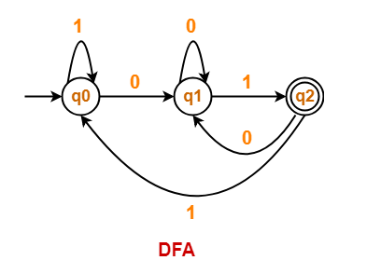
Examples
Draw a DFA for the language accepting strings ending with ’01’ over input alphabets ∑ = {0, 1}

Slide 4
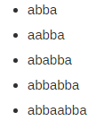
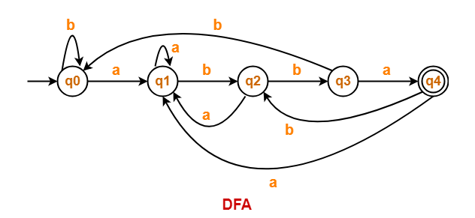
Examples (..contd)
Draw a DFA for the language accepting strings ending with ‘abba’ over input alphabets ∑ = {a, b}

Slide 5
Context-Free Grammars

Slide 6
Informal Comments
A context-free grammar is a notation for describing languages.
It is more powerful than finite automata or RE’s, but still cannot define all possible languages.
Useful for nested structures, e.g., parentheses in programming languages.

Slide 7
Informal Comments – (2)
Basic idea is to use “variables” to stand for sets of strings (i.e., languages).
These variables are defined recursively, in terms of one another.
Recursive rules (“productions”) involve only concatenation.
Alternative rules for a variable allow union.

Slide 8
Example: CFG for { 0^{n}1^{n} | n > 1}
Productions:
S -> 01
S -> 0S1
Basis: 01 is in the language.
Induction: if w is in the language, then so is 0w1.

Slide 9
CFG Formalism
Terminals = symbols of the alphabet of the language being defined.
Variables = non-terminals = a finite set of other symbols, each of which represents a language.
Start symbol = the variable whose language is the one being defined.

Slide 10
Productions
A production has the form
variable -> string of variables and terminals.
Convention:
A, B, C,… are variables.
a, b, c,… are terminals.
…, X, Y, Z are either terminals or variables.
…, w, x, y, z are strings of terminals only.
α, β, γ,… are strings of terminals and/or variables.

Slide 11
Example: Formal CFG
Here is a formal CFG for { 0^{n}1^{n} | n > 1}.
Terminals = {0, 1}.
Variables = {S}.
Start symbol = S.
Productions =
S -> 01
S -> 0S1

Slide 12
Derivations – Intuition
We derive strings in the language of a CFG by starting with the start symbol, and repeatedly replacing some variable A by the right side of one of its productions.
That is, the “productions for A” are those that have A on the left side of the ->.

Slide 13
Derivations – Formalism
We say αAβ => αγβ if A -> γ is a production.
Example: S -> 01; S -> 0S1.
S => 0S1 => 00S11 => 000111.

Slide 14
Iterated Derivation
=>* means “zero or more derivation steps.”
Basis: α =>* α for any string α.
Induction: if α =>* β and β => γ, then α =>* γ.

Slide 15
Example: Iterated Derivation
S -> 01; S -> 0S1.
S => 0S1 => 00S11 => 000111.
So, S =>* S; S =>* 0S1; S =>* 00S11; S =>* 000111.

Slide 16
Sentential Forms
Any string of variables and/or terminals derived from the start symbol is called a sentential form.
Formally, α is a sentential form iff S =>* α.

Slide 17
Language of a Grammar
If G is a CFG, then L(G), the language of G, is {w | S =>* w}.
Note: w must be a terminal string, S is the start symbol.
Example: G has productions S -> ε and S -> 0S1.
L(G) = {0^{n}1^{n} | n > 0}.
Note: ε is a legitimate
right side.

Slide 18
Context-Free Languages
A language that is defined by some CFG is called a context-free language.
There are CFL’s that are not regular languages, such as the example just given.
But not all languages are CFL’s.
Intuitively: CFL’s can count two things, not three.

Slide 19
BNF Notation
Grammars for programming languages are often written in BNF (Backus-Naur Form ).
Variables are words in <…>;
Example: <statement>.
Terminals are often multi-character strings indicated by boldface or underline; Example: while or WHILE.

Slide 20
BNF Notation – (2)
Symbol ::= is often used for ->.
Symbol | is used for “or.”
A shorthand for a list of productions with the same left side.
Example: S -> 0S1 | 01 is shorthand for S -> 0S1 and S -> 01.

Slide 21
BNF Notation – Kleene Closure
Symbol … is used for “one or more.”
Example: <digit> ::= 0|1|2|3|4|5|6|7|8|9
<unsigned integer> ::= <digit>…
Note: that’s not exactly the * of RE’s.
Translation: Replace α… with a new variable A and productions A -> Aα | α.

Slide 22
Example: Positive Closure
Grammar for unsigned integers can be replaced by:
U -> UD | D
D -> 0|1|2|3|4|5|6|7|8|9

Slide 23
BNF Notation: Optional Elements
Surround one or more symbols by […] to make them optional.
Example: <statement> ::= if <condition> then <statement> [; else <statement>]
Translation: replace [α] by a new variable A with productions A -> α | ε.

Slide 24
Example: Optional Elements
Grammar for if-then-else can be replaced by:
S -> iCtSA
A -> ;eS | ε

Slide 25
BNF Notation – Grouping
Use {…} to surround a sequence of symbols that need to be treated as a unit.
Typically, they are followed by a … for “one or more.”
Example: <statement list> ::= <statement> [{;<statement>}…]

Slide 26
Translation: Grouping
You may, if you wish, create a new variable A for {α}.
One production for A: A -> α.
Use A in place of {α}.

Slide 27
Example: Grouping
L -> S [{;S}…]
Replace by L -> S [A…] A -> ;S
A stands for {;S}.
Then by L -> SB B -> A… | ε A -> ;S
B stands for [A…] (zero or more A’s).
Finally by L -> SB B -> C | ε C -> AC | A A -> ;S
C stands for A… .

Slide 28
Leftmost and Rightmost Derivations
Derivations allow us to replace any of the variables in a string.
Leads to many different derivations of the same string.
By forcing the leftmost variable (or alternatively, the rightmost variable) to be replaced, we avoid these “distinctions without a difference.”

Slide 29
Leftmost Derivations
Say wAα =>_{lm} wβα if w is a string of terminals only and A -> β is a production.
Also, α =>*_{lm} β if α becomes β by a sequence of 0 or more =>_{lm} steps.

Slide 30
Example: Leftmost Derivations
Balanced-parentheses grammmar:
S -> SS | (S) | ()
S =>_{lm} SS =>_{lm} (S)S =>_{lm} (())S =>_{lm} (())()
Thus, S =>*_{lm} (())()
S => SS => S() => (S)() => (())() is a derivation, but not a leftmost derivation.

Slide 31
Rightmost Derivations
Say αAw =>_{rm} αβw if w is a string of terminals only and A -> β is a production.
Also, α =>*_{rm} β if α becomes β by a sequence of 0 or more =>_{rm} steps.

Slide 32
Example: Rightmost Derivations
Balanced-parentheses grammar:
S -> SS | (S) | ()
S =>_{rm} SS =>_{rm} S() =>_{rm} (S)() =>_{rm} (())()
Thus, S =>*_{rm} (())()
S => SS => SSS => S()S => ()()S => ()()() is neither a rightmost nor a leftmost derivation.

Slide 33
Thank You

